Slide 1
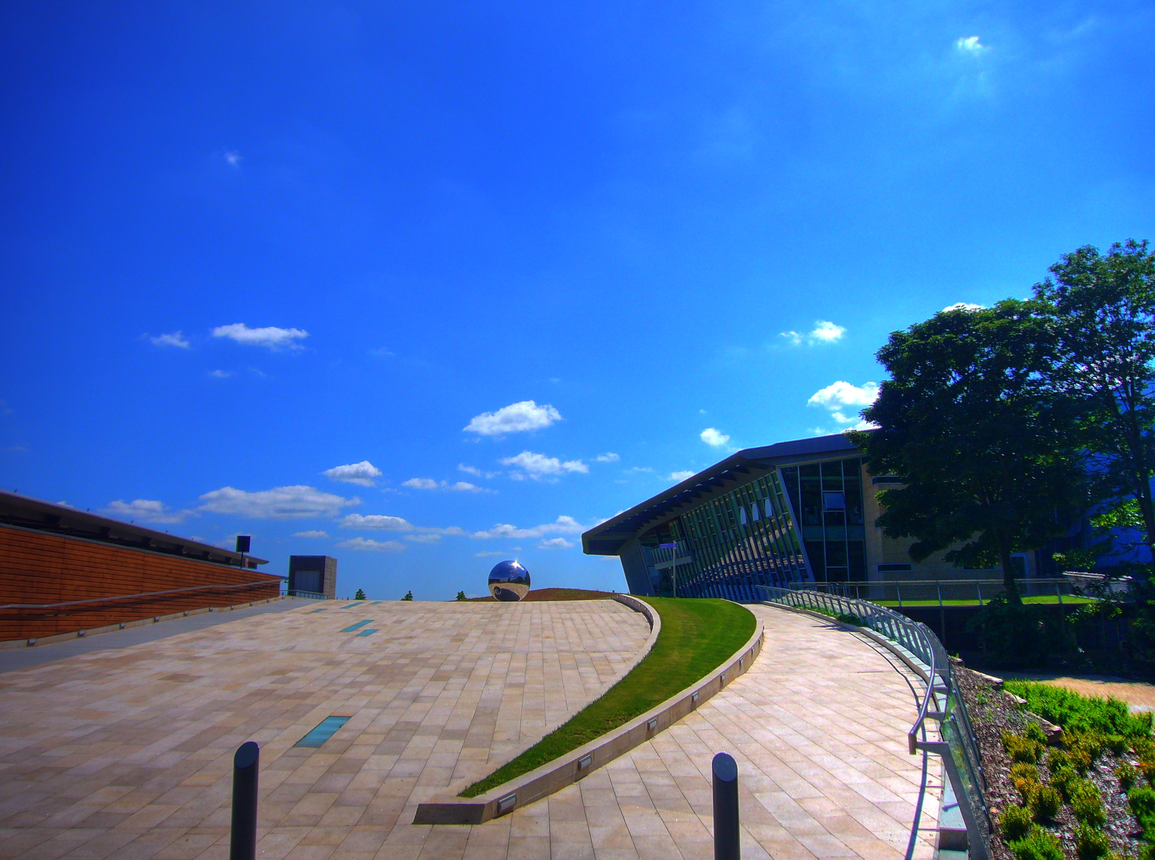

Basic UNIX Workshop
Volos Summer School
30 / 05 / 2017
Konstantinos Hatzikotoulas

Slide 2
What is UNIX
UNIX is an operating system family (analogous to DOS and Windows)
first developed in the 1960s
operating system, (OS)= suite of programs which make the computer work. It is a stable, multi-user, multi-tasking system for servers, desktops and laptops.

Slide 3
Welcome to UNIX
chr=3;ps=80088046; join -j1 <(join -j1 <(cat <(zgrep -m 1 CHROM /nfs/t144_helic/sequencing-data/HA-4x1x-seq/VQSR-filtered/$chr.hardfiltered.vcf.gz) <(tabix /nfs/t144_helic/sequencing-data/HA-4x1x-seq/VQSR-filtered/$chr.hardfiltered.vcf.gz $chr:${ps}-$ps) | ~/transpose-2.0/src/transpose -l 2000x2000 -t -f 200| grep -v NA | awk 'OFS=\"\\t\"{if(NF<2){$(NF+1)=\"NA\"}print}'| sed -f /nfs/t144_helic/sequencing-data/sample_tables/HA.sed | sed -f /nfs/t144_helic/sequencing-data/sample_tables/HA.duplicates.sed |sort -k1,1) <(cat <(zgrep -m 1 CHROM /nfs/t144_helic/sequencing-data/HA-4x1x-seq/imputed-firstpass/$chr.vcf.gz) <(tabix /nfs/t144_helic/sequencing-data/HA-4x1x-seq/imputed-firstpass/$chr.vcf.gz $chr:${ps}-$ps) | ~/transpose-2.0/src/transpose -l 2000x2000 -t -f 200 | grep -v NA | awk 'OFS=\"\\t\"{if(NF<2){$(NF+1)=\"NA\"}print}'| sed -f /nfs/t144_helic/sequencing-data/sample_tables/HA.sed | sed -f /nfs/t144_helic/sequencing-data/sample_tables/HA.duplicates.sed |sort -k1,1)) <(cat <(zgrep -m 1 CHROM /nfs/t144_helic/sequencing-data/HA-4x1x-seq/imputed-secondpass/$chr.vcf.gz) <(tabix /nfs/t144_helic/sequencing-data/HA-4x1x-seq/imputed-secondpass/$chr.vcf.gz $chr:${ps}-$ps) | ~/transpose-2.0/src/transpose -l 2000x2000 -t -f 200 | grep -v NA | sort -k1,1) | sort -k1,1 -r | tr ' ' '\\t' | grep -e '1|' -e '|1' -e '1/' -e '/1' -e CHROM -e POS -e FILTER -e INFO -e FORMAT -e REF -e ALT -e QUAL|less

Slide 4
The UNIX operating system
UNIX itself is not used anymore
Linux (Fedora, Arch, Ubuntu, Red Star Linux) is its successor
UNIX-based systems do not rely on a graphical interface
With UNIX, you don’t use the mouse!
Linux often comes with a window-manager and advanced graphical support, but advanced users still use a terminal emulator

Slide 5
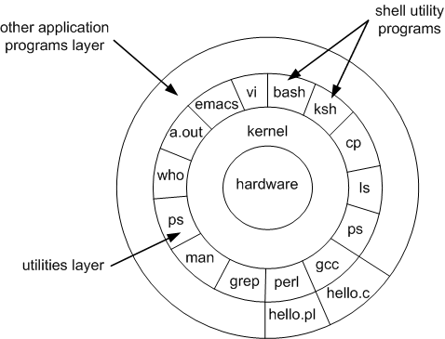
The UNIX operating system
The kernel is the core of the OS, the part that interacts with the processor, memory…
The shell is what you see when you open a command line. It allows the user to interact with the kernel.
The shell has only a few basic commands (mostly file management). Other applications can be built to interact with the kernel and can be called in the shell.

Slide 6
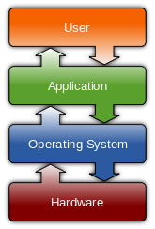
What happens when I type a command?

Slide 7
Text-only, you say?
Every action has to be typed on the screen and sent to the system with Enter
You are always in a directory, every command you send will affect the current directory unless stated otherwise
Remember where
you are!

Slide 8
Text-only, you say?
It is now forgotten, but all historical computers ran on text-only interfaces (MS-DOS before Windows, OS/2 before Mac OS)
They are really useful for file and data manipulation
On Windows, we use emulators (which imitate UNIX behaviour) and remote access programs (which connect to real UNIX systems)

Slide 9
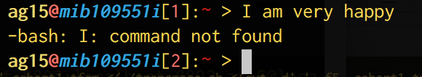
Text-only, you say?
When you send a command, the system will look it up
If it is a system command, it will execute it itself
If not, it will look if it’s a third-party program installed on the computer
If not, it will yell at you.

Slide 10
The “frightening black screen with
weird text on it”
user1@host:~$ find –iname “*.txt”
What the computer writes
« the command prompt »
The arguments
« these are my criteria »
The command
« find a file that match certain criteria »

Slide 11
The command prompt
user1@host:~$
Username @ name of the computer : current directory $

